Slide 1
Implementation of the Enomy-Finances Application
NAME – M.M.M AASHIK
ROLE - Junior Software Developer at Phonyt Digital Solutions (PDS)

Slide 2

Enomy-Finances
Enomy-Finances is an organisation in the financial sector.
This organisation provides advice and services related to mortgages, savings and investments.
Their goals –
  Develop a new Computer System to calculate currency conversions and provide investment quotes, and secure data storage.
  Web-based platform for improved accessibility
Key Requirements of the system
  Easy-to-use interface.
  Real-time currency and investment data updates.
  Secure storage and user data protection.

Slide 3
Scope of the System
Currency Conversion Phase | Investment & Savings Phase
Input: Currency value, current exchange rate. Output: Converted amount in target currency, transaction fee. Process: Convert input amount using current exchange rates and apply transaction fees. Security Considerations: Encrypt user data, use secure API for live exchange rate data. | Input: Initial lump sum, monthly investment, Time Period, investment type. Output: Predicted return, fees, taxe Personalized Investment Quote. Process: Investment Calculation,fee calculation,error handling ,data validation . Security Considerations: Secure transaction history, user data encryption.

Slide 4
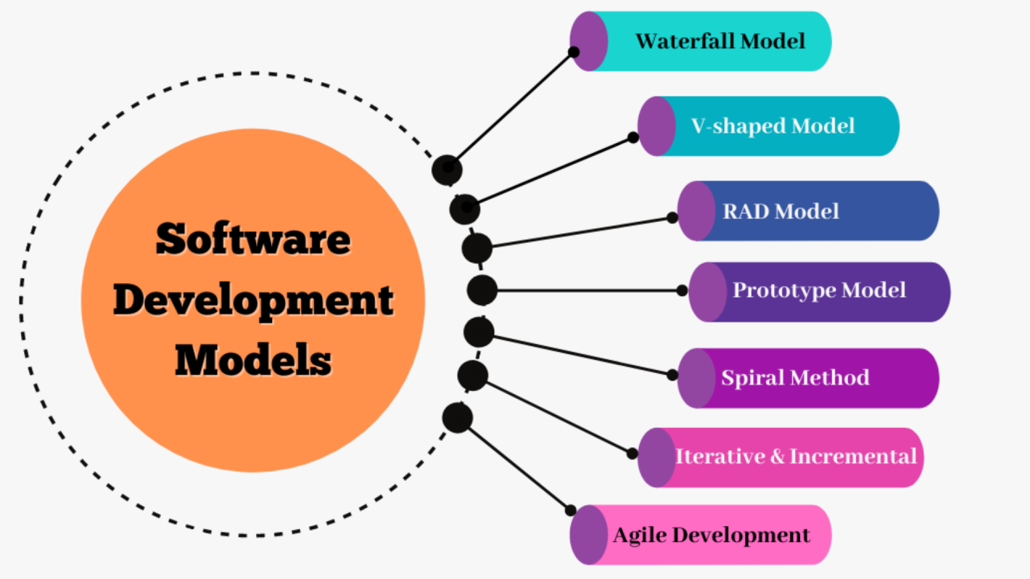
Given below are various SDLC models that Phonyt Digital Solutions (PDS) could use for Enomy-Finances are
Waterfall: Sequential, rigid, best for projects with fixed requirements.
V-Model: Extension of waterfall, emphasizes validation and verification at each stage.
RAD Model -that emphasizes quick and iterative release cycles
Spiral: Combines elements of iterative and waterfall models, focuses on risk assessment.
Agile: Iterative, flexible, best for projects with evolving requirements.

Slide 5
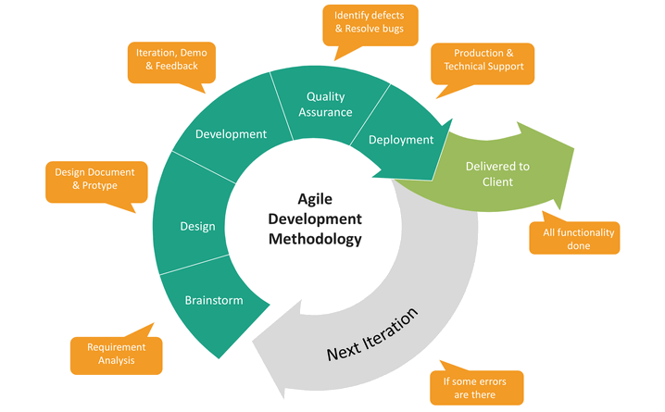
AGILE METHODOLOGY
WHY AGILE?
Frequent releases and iterative feedback ensure that the application aligns with user needs.
Allows for quick adjustments based on changing market conditions and financial regulations.
Facilitates close collaboration with stakeholders, which is crucial for a client-facing application

Slide 6
Why Agile is the best fit for the Enomy-Finances project?
Agile is ideal for the Enomy-Finances system
  Because it provides flexibility in the development process to adapt to changing financial regulations and market demands.
  Its iterative approach ensures continuous delivery of functional components, allowing for early feedback and improvements.
  Regular collaboration with stakeholders ensures the solution aligns with business goals, while frequent testing reduces risks and enhances system reliability.
  Agile's focus on adaptability and quality makes it a strong choice for developing a complex, user-centric financial application.

Slide 7
Functional Requirements
Currency conversion between multiple currencies.
Real-time updates of exchange rates.
Investment and savings calculations based on user inputs
Maintain contact information, credentials, and roles for financial advisors and administrative staff.
Allow clients to access financial planning tools, view investment portfolios, and generate savings or investment quotes online.
Maintain records of all client interactions, including consultations, transaction histories, and saved financial plans.
New clients are registered, their personal and financial information is recorded, and unique client identification numbers are assigned and Manage clients' financial plans, including savings, investment options, and personalized portfolio recommendations.

Slide 8
Non-Functional Requirements
Performance: Fast response time for currency conversion and financial calculations.
Security: Encryption of sensitive data, secure login, compliance with regulations.
Scalability: Support for an increasing number of users and transactions.
Usability: Simple, intuitive user interface with minimal learning curve

Slide 9
Stakeholder Requirements
Stakeholder | Key Requirements
Clients (End Users) | User-friendly interface, real-time currency conversion, data security, error handling, transaction history.
Company Management | Scalability, secure data storage, regulatory compliance, reporting, cost control.
Development Team | Clear requirements, access to tools, testing environment, documentation, collaboration.
Regulatory Bodies | Compliance with regulations, data privacy, auditing and reporting capabilities.
IT Support | System maintenance, performance monitoring, backup & disaster recovery.
Marketing & Sales | Customer insights, user acquisition, customer support integration.

Slide 10
Timeline and Milestones
  Development Phases:
    Phase 1: Requirements gathering and system design (2 weeks).
    Phase 2: Initial development of currency conversion and investment modules (4 weeks).
    Phase 3: Integration and testing (3 weeks).
    Phase 4: Deployment and feedback collection (2 weeks).
    Phase 5: Ongoing maintenance and updates.

Slide 11
Potential risks associated with system
  Identified Risks:
    Data Security: Protecting sensitive client information.
    Integration Issues: Ensuring seamless data flow between modules (currency conversion, investment management).
    Performance: Ensuring the system can handle high volumes of real-time data without crashes or delays.
  Risk Mitigation:
    Regular security audits and encryption of user data.
    Thorough testing of integrations.
    Load testing and performance optimization

Slide 12
Development Tools
Visual Studio (for IDE):
  Reason for Selection: Visual Studio supports various programming languages and offers built-in version control, which is essential for managing code in an Agile development environment.
  It allows for seamless debugging and integration with Git, streamlining the development process and ensuring high-quality code.
MySQL Workbench (for Database Management):
  Reason for Selection: As a relational database management system, MySQL Workbench is optimal for storing the financial data required for transactions and investment calculations.
  It ensures data integrity, scalability, and security, which are crucial for financial applications.
React.js (for Web Development):
  Reason for Selection: React.js allows for the creation of responsive, interactive web applications, which is essential for the transition to a web-based solution.
  It supports component-based development, making it easier to maintain and scale the application over time.

Slide 13
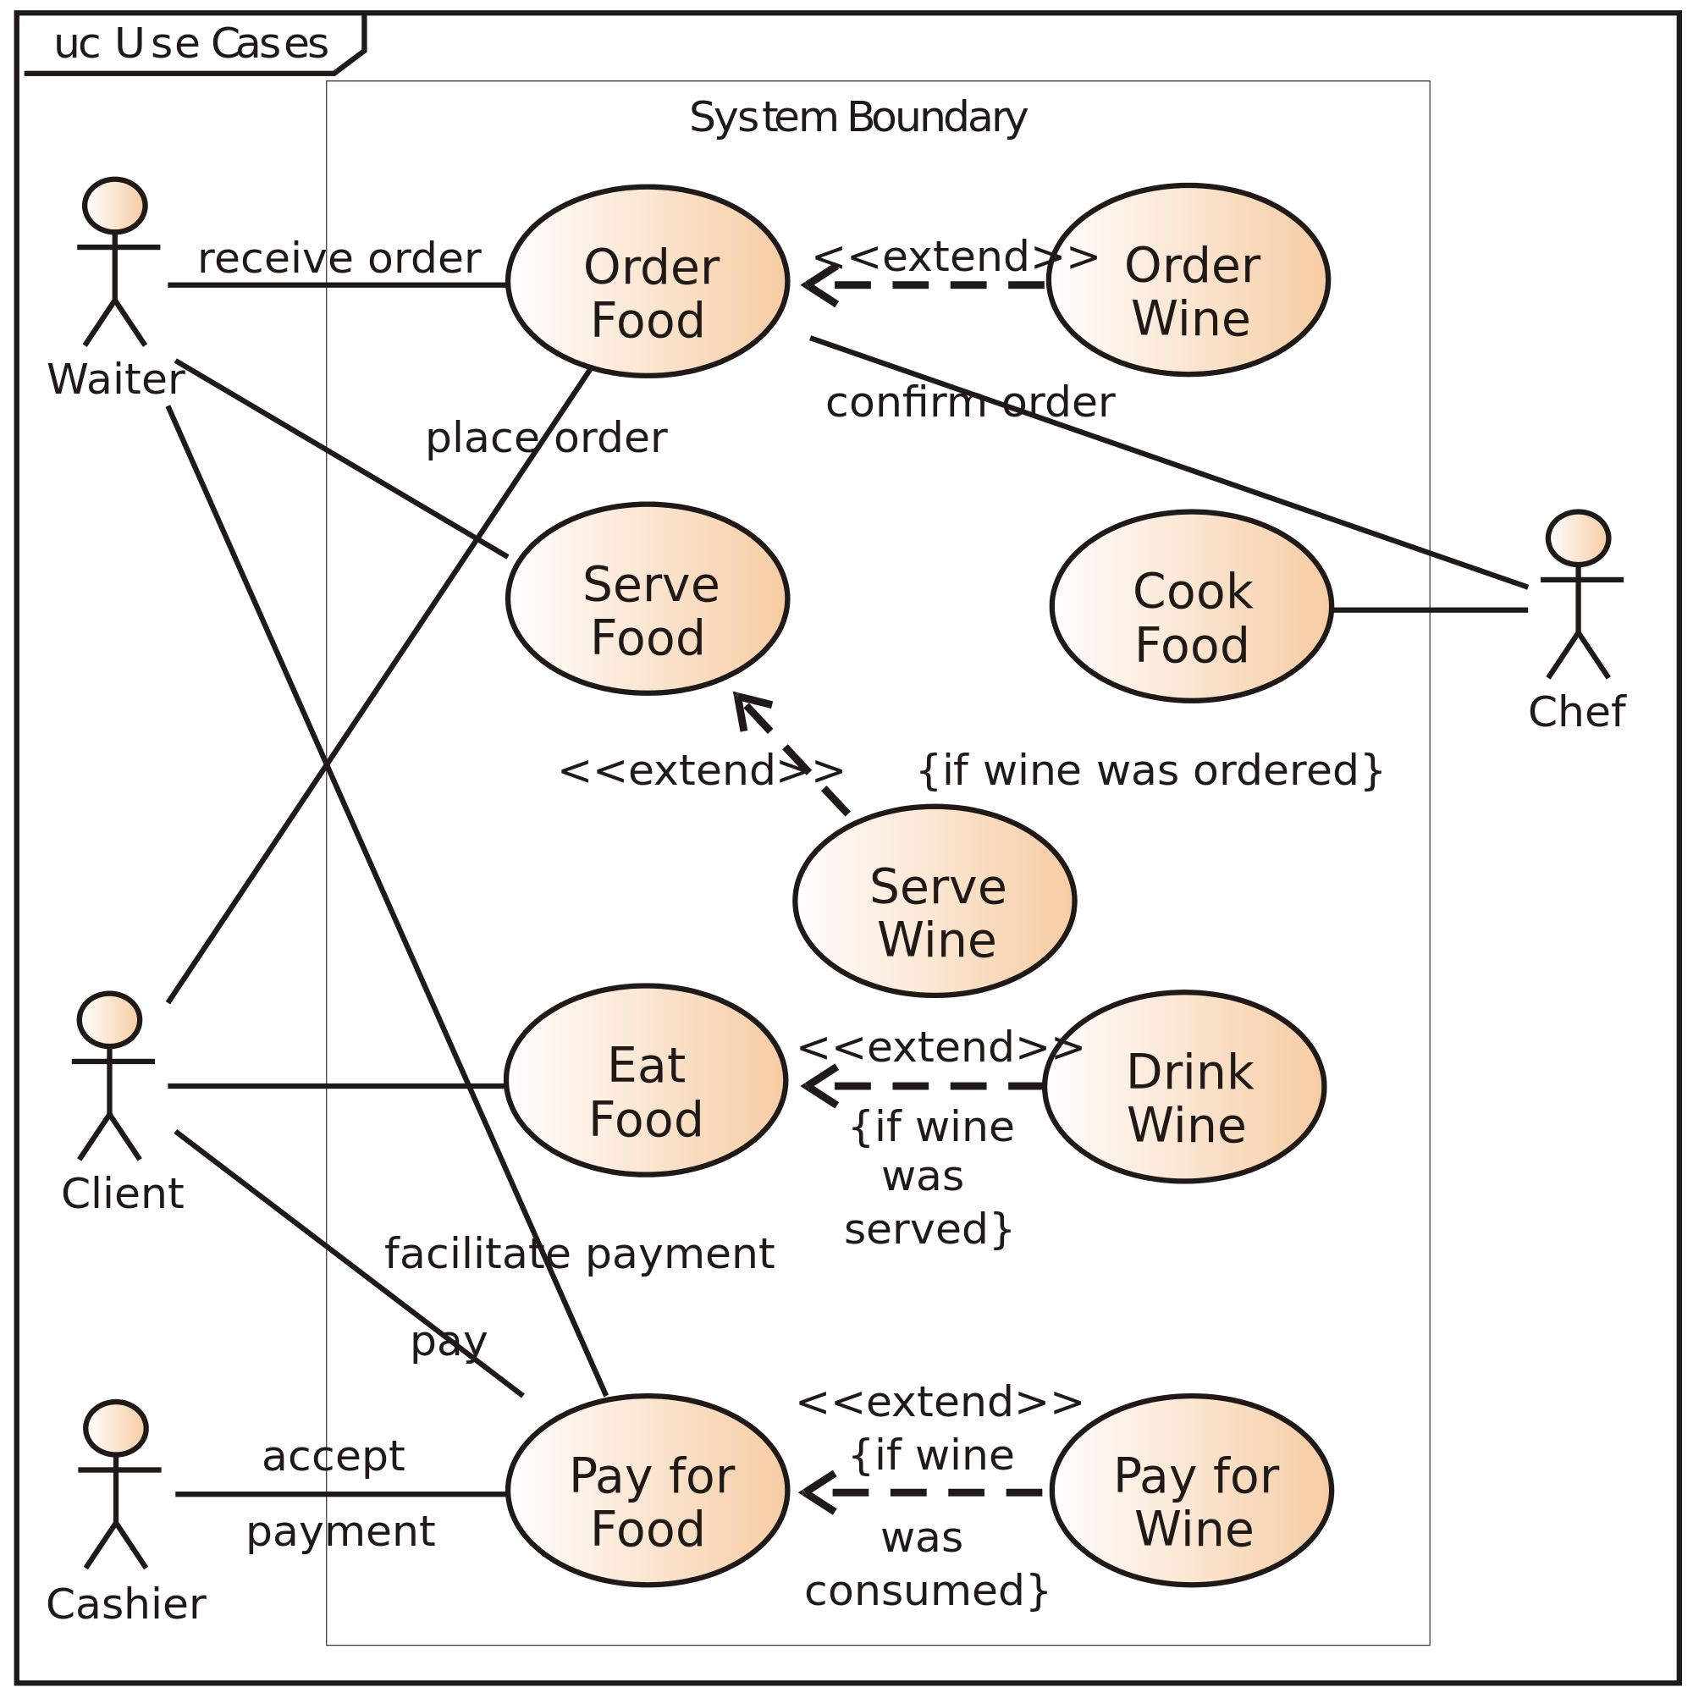
Design Tools
1. Unified Modelling Language (UML)
UML is a standardized modeling language comprised of an integrated set of diagrams designed to assist system and software developers in specifying, visualizing, constructing, and documenting software system artifacts, as well as business modeling and other non-software systems.
Wireframing Tools -To design a user-friendly interface for both clients and staff.
2. Flowcharting and Diagram Tools (e.g., Lucid chart, Visio)
Purpose: To create flowcharts, DFDs, and ERDs for visualizing processes, data flow, and relationships.
Benefits: Simplifies complex systems, improves clarity, and aids stakeholder understanding.
3. Pseudo code Editors
Purpose: To outline algorithms and logic in a clear, language-agnostic format.
Benefits: Helps in planning before coding, minimizing errors in development.

Slide 14
Security Considerations
Data Encryption: All sensitive data, including user financial information and transaction records, should be encrypted both at rest and in transit
Authentication and Authorization: Implement strong user authentication mechanisms (e.g., multi-factor authentication) to ensure that only authorized users can access their accounts and perform transactions.
Access Control: Implement role-based access control (RBAC) to ensure that only users with the necessary permissions can access or modify sensitive information.
Regular Audits and Monitoring: Regular security audits should be performed, and the system should log all access and transactions for monitoring and potential security breaches.
Data Backup and Recovery: Regular backups of user data and transaction history should be performed, and there should be a disaster recovery plan in case of system failure or data loss.

Slide 15
Constraints for the Enomy-Finances Project
1. Financial Constraints
Budget Limitations: The project has a fixed budget allocated for development, deployment, and maintenance. Any significant deviation from the planned budget could affect the overall feasibility of the project.
Operational Costs: The project needs to consider the ongoing operational costs, including licensing fees, maintenance, and server hosting costs. These costs should be accounted for in the feasibility study.
2. Technological Constraints
Legacy Systems Integration: The current system is built on a client-server architecture, and moving to a web-based application could introduce challenges related to data integration and system compatibility. The project needs to address how to integrate legacy systems with the new web-based application.
Third-Party Dependencies: If the project relies on third-party APIs for currency conversion or financial data, it will have to account for potential changes in third-party API pricing, data availability, or changes to data access policies.

Slide 16
Alternate Solutions
Currency Conversion phase
Alternate Solution 1: Use a pre-built currency conversion API instead of developing a custom conversion service. This would reduce development time but may introduce dependency on an external service.
Alternate Solution 2: Develop a dedicated server-side service that fetches exchange rates periodically from multiple sources (e.g., banks or financial APIs) to ensure the most accurate rates.
Savings and Investment Module:
Alternate Solution 1: Use a third-party financial service provider API to calculate expected returns and taxes, rather than building custom algorithms for these calculations. This would save time but could limit flexibility and control.
Alternate Solution 2: Use a client-side calculation module, allowing faster results and reducing server load, but this might compromise security, especially regarding sensitive financial data.

Slide 17
Technical Constraints
Technology Stack Limitations: The choice of technology stack for development could impose constraints, such as limited access to certain features or slower development times. The project needs to select a stack that aligns with organizational goals and provides the best balance between functionality and technical limitations.
Server Requirements: The deployment of a web-based application requires robust server infrastructure to handle database storage, transaction processing, and data retrieval from external APIs. The project must consider server capacity, load balancing, and fault tolerance as key technical constraints.
4. Time Constraints
Time for Development and Testing: The project must meet deadlines for development and testing phases. Delays in development could affect the project’s launch date and customer expectations.
Time for System Integration: The project must allocate adequate time for integration between different system components, such as the client application and the server-side data processing, which can introduce delays if not managed properly.

Slide 18
Conclusion
Agile is the recommended SDLC model for flexibility, enabling rapid iteration and responsiveness to changing requirements, especially in a dynamic field like finance.
By incorporating Regular feedback from stakeholders and regular testing phases, we guarantee that the system will evolve to meet and exceed user expectations, delivering a robust and user-friendly platform for Enomy-Finances.

Slide 19

THANK YOU

